Slide 1
Week 6 – Lecture Notes
Root cause analysis - Identify causal relationship

Slide 2
Root Cause

Slide 3
What is a root cause?
Root Cause:
The causal or contributing factors that, if corrected, would prevent recurrence of the identified problem.
The factor that caused a problem or defect which should be permanently eliminated through process improvement.
The factor that sets in motion the cause and effect chain that creates a problem .
The “true” reason that contributed to the creation of a problem, defect or nonconformance.

Slide 4
Why determine root cause?
Prevent problems from recurring
Eliminate operation and financial risks
Protect organizations reputation
Reinforce accountability and responsibility
Reduce human casualties, financial and resources losses
Minimizing scrap and rework

Slide 5




Why determine root cause?
Common approach:
Problem Identified
Firefighting!
Immediate Containment Action Implemented
Problem reoccurs elsewhere!
Find someone to blame!
Preferred approach:
Immediate Containment Action Implemented
Defined Root Cause Analysis Process
Solutions validated with data
Problem Identified
Problems never return!

Slide 6
Look beyond the Obvious
Invariably, the root cause of a problem is not the initial reaction or response. It is not just restating the Finding.
For example, a normal response is:
Process failure
Equipment faulty
Human error
Initial response is usually the symptom, not the root cause of the problem. This is why Root Cause Analysis is a very useful and productive tool.

Slide 7
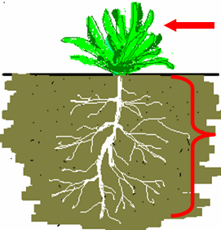
What is Root Cause Analysis
Root Cause Analysis (RCA) is a set of techniques that are used as in-depth process for identifying the source factor(s) underlying a variation in performance (problem).
The focus of RCA is on systems and processes, not on individuals.
Symptom of the problem (Obvious).
The underlying causes (Not obvious).
Notes:
The word “root”, in RCA, refers to the underlying causes, not the one cause.

Slide 8
When should RCA be performed
Significant or consequential events
Repetitive human errors are occurring during a specific process
Repetitive equipment failures associated with a specific process
Performance is generally below desired standard
May be SCAR or CPAR (NGNN) driven
Repetitive VIRs

Slide 9
Essential Tools for Root Cause Analysis
The “5 Whys”
Pareto Analysis (Vital Few, Trivial Many)
Cause and Effect Diagram (Fishbone/Ishikawa diagram)
Tree Diagram
Workflow / Process Mapping
Brainstorming

Slide 10
Advanced Tools for Root Cause Analysis
Probabilities and association rules analysis
Classification and clustering of historical data
Quantitively and qualitative analysis
Supervised and un-supervised learning
Process mining, sentiment analysis, tree mining
Conjoint data mining – multiple data sources

Slide 11

Technique 1: Five “Whys” for RCA
Problem: Flat Tyre
Why? - Nails on garage floor
Why? - Box of nails on shelf split open
Why? - Box got wet
Why? - Rain thru hole in garage roof
Why? - Roof shingles are missing

Slide 12
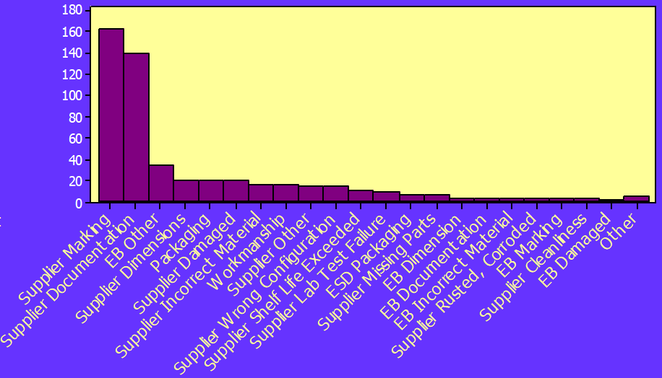
Technique 2: Pareto Analysis
Counts of reasons appear
Reasons for supplier material rejections
60% of Material Rejections
Vital Few
Trivial Many
Types of reasons
Notes:
How To Construct A Pareto Chart:
A pareto chart can be constructed by segmenting the range of the data into groups (also called segments, bins or categories). For example, if your business was investigating the escape of GM traits, you could group the data into the following categories:
# Outside Providers
# Site Selection
# Storage
# Movement
The left-side vertical axis of the pareto chart is labeled Incident or Frequency (the number of counts for each category), the right-side vertical axis of the pareto chart is the cumulative percentage, and the horizontal axis of the pareto chart is labeled with the group names of your response variables.

Slide 13


Technique 3: Cause & Effect Diagram
(Fishbone / Ishikawa Diagrams)
Cause & Effect Diagram is also known as Fishbone diagrams (For their appearance) and Ishikawa diagrams (named after their developer Kaoru Ishikawa) [1].
Notes:
[1]: https://en.wikipedia.org/wiki/Ishikawa_diagram

Slide 14
Technique 3: Cause & Effect Diagram
(Fishbone / Ishikawa Diagrams)
CAUSES (METHODS)
EFFECT (RESULTS)
MAN/WOMAN
METHODS
EFFECT
OTHER
MATERIALS
MACHINERY
“4M” method [2]
Notes:
[2]: https://www.matec-conferences.org/articles/matecconf/pdf/2018/42/matecconf_qpi2018_03006.pdf

Slide 15
Example: Covid-19
MAN/WOMAN
METHODS
Return from overseas
Bad quarantine management
Do not take it seriously
Do not suggest to wear masks
Do not follow social distance
Open state boarders too soon
Covid-19 second wave in Australia
OTHER
No effective cure
Late regulation
Not enough care for the elderly
Not enough ICU
Not enough masks for sale
Insufficient enforcement
MATERIALS
MACHINERY
Notes:
[1]: https://www.matec-conferences.org/articles/matecconf/pdf/2018/42/matecconf_qpi2018_03006.pdf

Slide 16
Technique 4: Fault Tree for Covid-19
Open state borders too soon
Incorrect national policies
Open public places too early
Inadequate action from the leader
Lack of strict quarantine restrictions
Lack of efficient border control
No virus testing for overseas travelers
Poor guidance
Covid-19 second wave in Australia
Citizen not pay attention
Disregard social distance
Insufficient understanding
Failure to follow quarantine rules
Do not wear masks
Inability to cope emergencies in hospitals
Lack of personnel training
Limited virus examination range
Shortage of medical supplies
Unstrict self-quarantine rules
Result
Primary Causes
Secondary Causes
Tertiary Causes

Slide 17
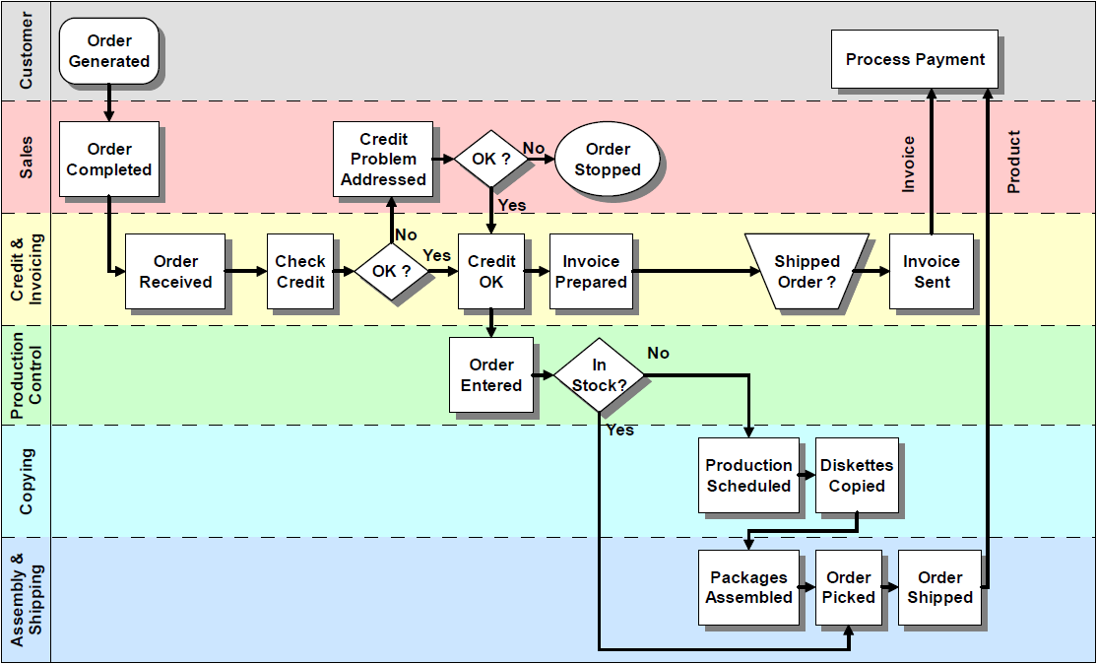
Technique 5 : Workflow / Process Mapping
A flowchart is a type of diagram that represents a workflow or process[3].
An example:
Notes:
[3]: https://en.wikipedia.org/wiki/Flowchart

Slide 18
RCA analysis process with an illustrative example
Identify Problem:
A manager walks past the assembly line and notices a puddle of water on the floor. Knowing that the water is a safety hazard, she asks the supervisor to have someone get a mop and clean up the puddle. The manager is proud of herself for “fixing” a potential safety problem.
But What is the Root Cause?
The supervisor needs to look for a root cause by asking 'why?’

Slide 19
Root Cause Analysis Example
Puddle of water on the floor
Why?

Slide 20
Root Cause Analysis Example
Puddle of water on the floor
Why?
Leak in overhead pipe
Why?

Slide 21
Root Cause Analysis Example
Puddle of water on the floor
Why?
Leak in overhead pipe
Why?
Water pressure is set too high
Why?

Slide 22
Root Cause Analysis Example
Puddle of water on the floor
Why?
Leak in overhead pipe
Why?
Water pressure is set too high
Why?
Water pressure valve is faulty
Why?

Slide 23
Root Cause Analysis Example
Puddle of water on the floor
Why?
Leak in overhead pipe
Why?
Water pressure is set too high
Why?
Water pressure valve is faulty
Why?
Root Cause
Valve not in preventative maintenance program

Slide 24
Corrective Action
Permanent – Water pressure valves placed in preventative maintenance program.
Preventive – Developed checklist form to ensure new equipment is reviewed for possible inclusion in preventative maintenance program.

Slide 25
Takeaways
The result of RCA is only as good as the quality of the collected data.
One has to understand what has happened before you can understand why it happened.
It is impossible to solve all human performance problems with discipline, training, and procedures.
Even if the root causes are found, it is still hard to see the effective relationship between the “root” and the “weed”.

Slide 26
Advanced reading -
Probability and Association Rules

Slide 27
Events and Probabilities
Uncertainty is an ever-present fact of life for decision makers. Much time and effort are spent trying to plan for and respond to uncertainty.
Probability is the numerical measure of the likelihood that an event will occur.
  Extremely helpful in providing additional information about an event.
  Can be used to help a decision maker evaluate possible actions and determine best course of action.

Slide 28
Events and Probabilities
A random experiment is a process that generates well-defined experimental outcomes.
Examples:
Random Experiment | Experimental Outcomes
Toss a coin | Head, tail
Roll a die | 1, 2, 3, 4, 5, 6
Conduct a sales call | Purchase, no purchase
Hold a particular share of stock for one year | Price of stock goes up, price of stock goes down, no change in stock price
Reduce price of product | Demand goes up, demand goes down, no change in demand

Slide 29
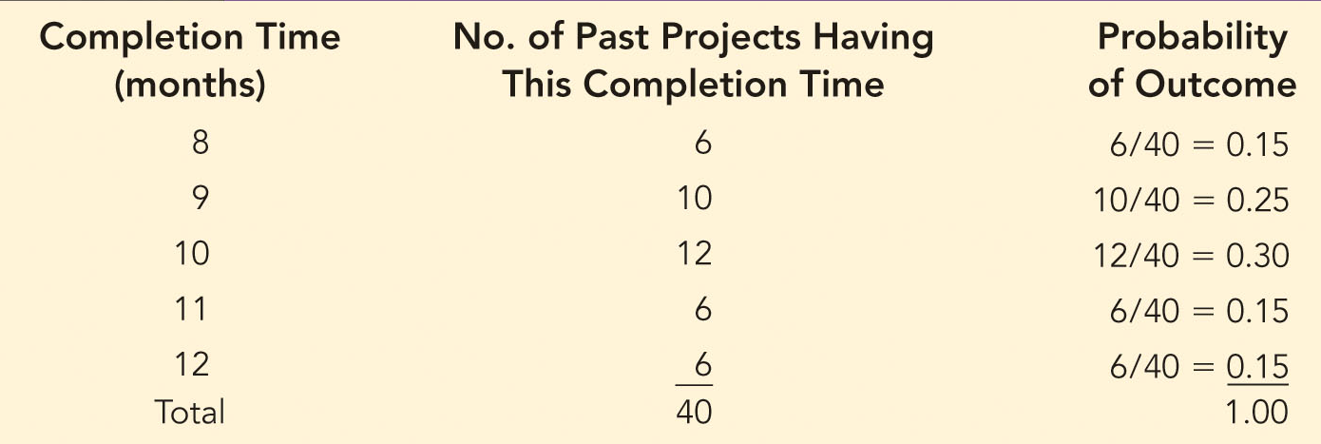
Events and Probabilities
Example: California Power & Light Company (CP&L).
CP&L is starting a project designed to increase the generating capacity of one of its plants in southern California.
Analysis of similar construction projects indicates that the possible completion times for the project are 8, 9, 10, 11, and 12 months.

Slide 30
Events and Probabilities
The probability of an event is equal to the sum of probabilities of outcomes for the event.
In the CP&L example: Let C denote the event that the project is completed in 10 months or less, C = {8,9,10}.
The probability of event C, denoted P(C) can be calculated as:
We can tell CP&L management that there is a 0.70 probability that the project will be completed in 10 months or less.

Slide 31
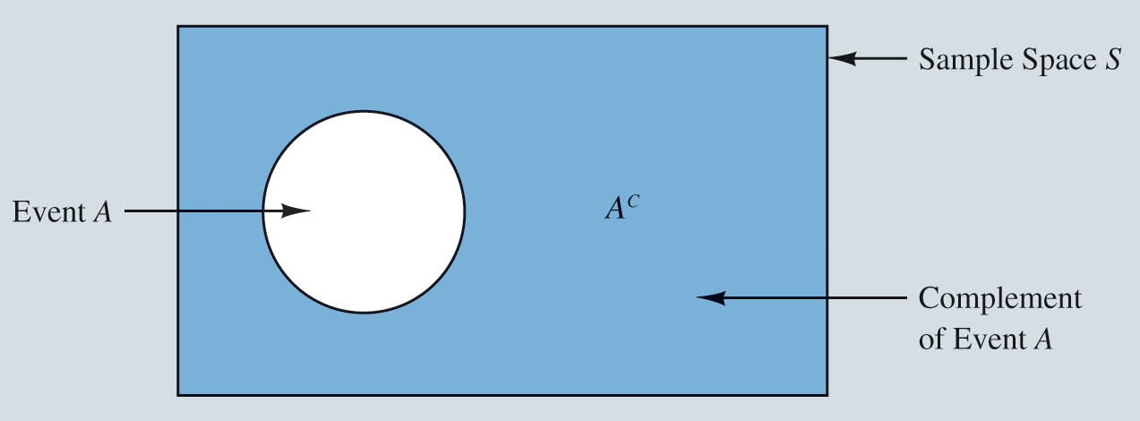
Basic Relationships of Probabilities
Venn diagram is a diagram that shows all possible logical relationships between a finite collection of event outcomes.
  Rectangular area represents the sample space for the random experiment and contains all possible outcomes.
  Circle represents event A and contains only the outcomes that belong to A.
  Shaded region of the rectangle contains all outcomes not in event A.

Slide 32
Basic Relationships of Probabilities
Completion of an Event:
Given an event A, the complement of A is defined to be the event consisting of all outcomes that are not in A.
If the probability of event A occurs is denoted P(A), then the complement of A is P(A^{C}), and their relationship is:

Slide 33
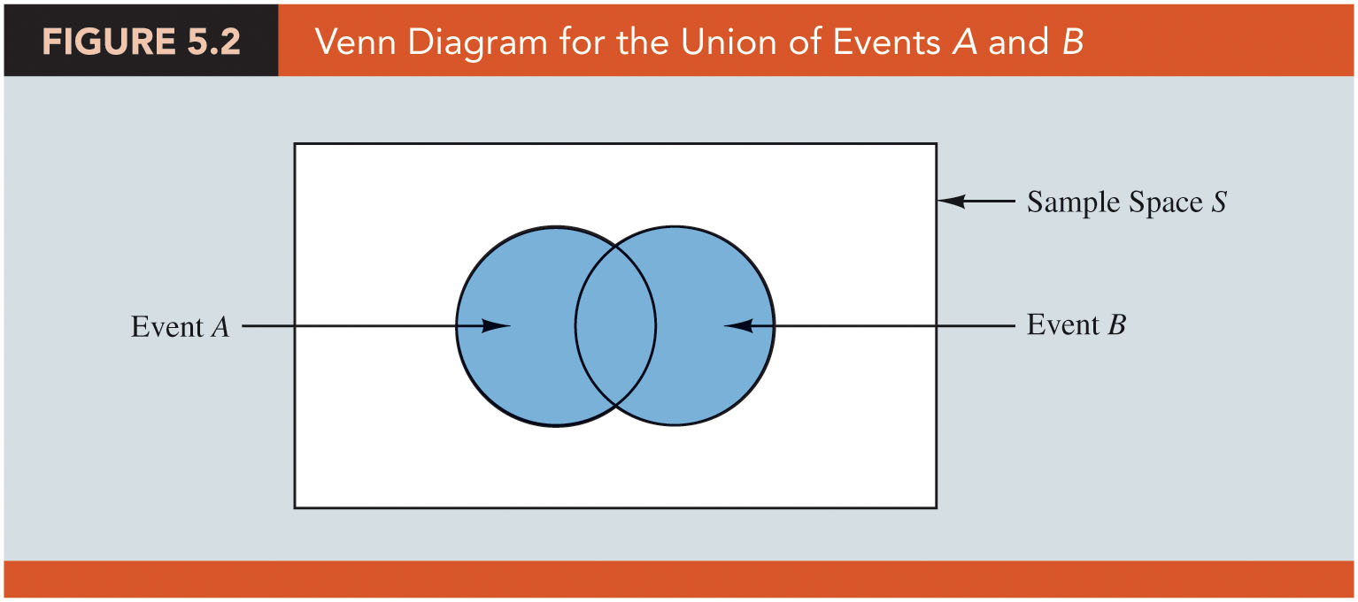
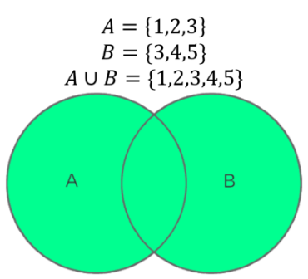
Basic Relationships of Probabilities
The Union of event A and event B is defined as the event containing all outcomes belonging to A or B or both. The union of A and B is denoted by A∪B, which is depicted in the following Venn diagram.
  One circle contains all the outcomes of A.
  The other circle contains all the outcomes of B.

Slide 34
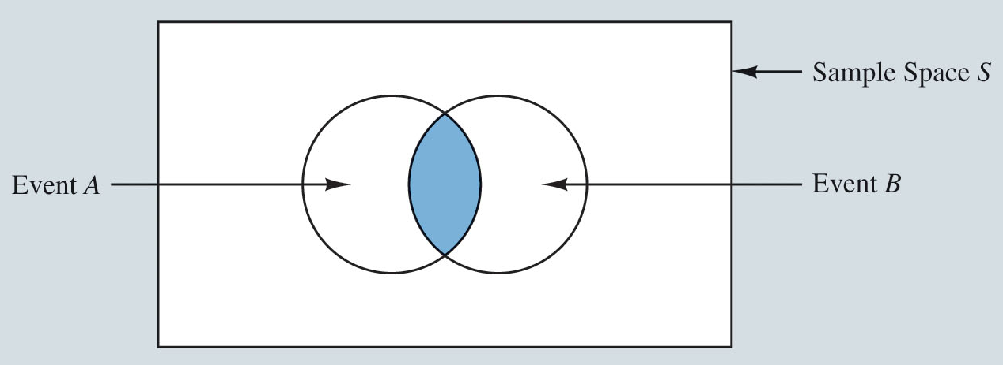
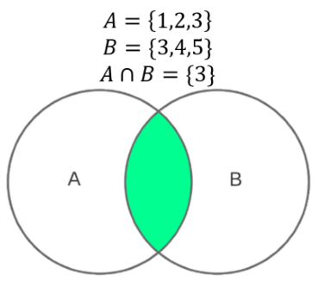
Basic Relationships of Probabilities
The intersection of event A and event B is the event containing the outcomes that belong to both A and B, The intersection of A and B is denoted by A∩B, which is depicted in the following Venn diagram.
  The area in which the two circles overlap is the intersection.
  It contains outcomes that are in both A and B.

Slide 35
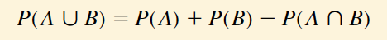

Basic Relationships of Probabilities
The addition law provides a way to compute the probability that event A or event B or both will occur. The law is defined as:
A special case arises for mutually exclusive events:
  If the occurrence of one event precludes the occurrence of the other.
  If the events have no outcomes in common.
Probability of A or B occurs
Probability of both A and B occurs
Probability of A occurs
Probability of B occurs

Slide 36
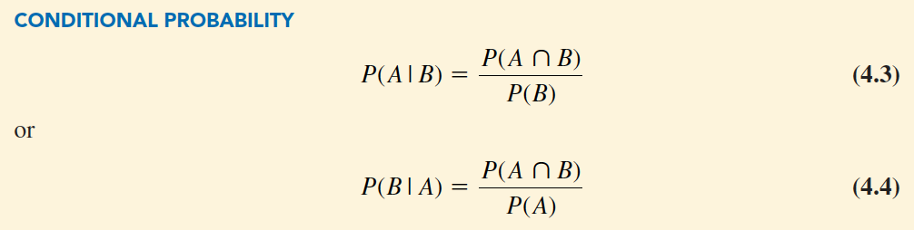
Basic Relationships of Probabilities
Conditional probability: When the probability of one event is dependent on whether some related event has already occurred.
The ratio of the probability of both A and B occurs to the probability of only B occurs
Probability of A occurs on the condition of B occurs
Probability of B occurs on the condition of A occurs
The ratio of the probability of both A and B occurs to the probability of only A occurs

Slide 37
Association Rules
Association rules: “If-then” statements which convey the probability of events occur together.
Antecedent: The number of occurred events corresponding to the “if” portion of the rule.
Consequent: The number of occurred events corresponding to the “then” portion of the rule.
An Example: If there is a McDonald, there will probably be a Hungry Jake near by.

Slide 38
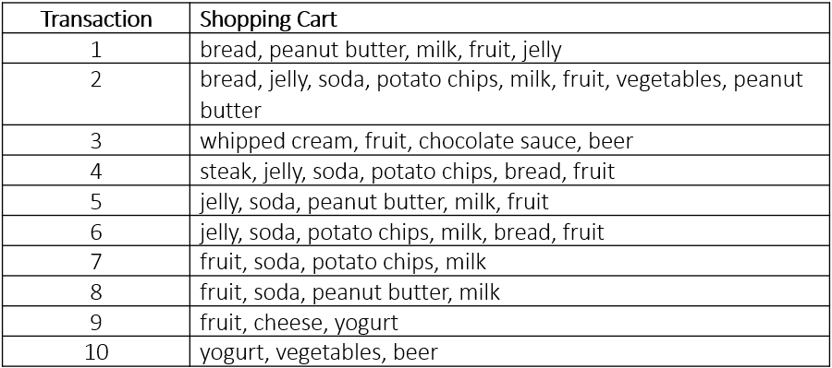
Association Rules
Hy-Vee grocery store would like to gain insight into its customers’ purchase patterns to possibly improve its in-aisle product placement and cross-product promotions.
The following table contains a small sample of data where each transaction comprises the items purchased by a shopper in a single visit to a Hy-Vee.

Slide 39
Association Rules
  An example of an association rule from this data would be “if {bread, jelly}, then {peanut butter}” meaning that “if a customer purchases bread and jelly, he/she will also buy peanut butter.”
    Antecedent - {bread, jelly},
    Consequent - {peanut butter}
The support count of this association rule “if {bread, jelly}, then {peanut butter}” is 2.
Because only in these two transactions, the customer purchased bread, jelly, and also bought peanut butter.

Slide 40

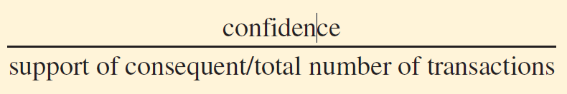
Association Rules
Confidence: Helps identify the reliability of association rules:
Lift ratio: Measure to evaluate the efficiency of a rule:
For the Hy-Vee example, the rule “if {bread, jelly}, then {peanut butter}” has confidence = 2/4 = 0.5 and a lift ratio = 0.5/(4/10) = 1.25.

Slide 41
More advanced studies - will be introduced in the following weeks

Slide 42
Conclusion and Notes
Reading materials for this week:
PPT lecture note
Textbook 1 (Page 233-235, 245-247)
Textbook 2 (Page 148-150, 167-176)
Collaboration Session record
In this week tutorial, we will show how to use RapidMiner to analyse root cause and develop association rules on real life data.

